Slide 1
Entrepreneurial Opportunities and Kevin Hindle MEP Model
Dr. Muhammad Tariq Yousafzai

Slide 2
Lecture Objectives
Understand various views on opportunities such as the Creation View, Discovery View and the idiosyncratic views of opportunities under the overall umbrella of Schumpeterian and Kirznerian Opportunities View
To discuss the entrepreneurial process with the help of Kevin Hindle Paper containing Model of Entrepreneurial Process MEP.
Understand concepts of Effectuation, Bricolage and Causation and how 32 models have been embedded into one.
To understand the strategic, tactical and Personal domains in relation to:
Entrepreneurial, Psychological, and managerial capacities
Discuss the concept of New Means-Ends framework for value creation

Slide 3
Three views of “Opportunities”and the entrepreneurial process
As varying crude classification can never do justice to individual works.
Therefore Alvarez et al (2013) has classified three different perspectives such as discovery view, creation and evolving idiosyncrasy which are discussed henceforth.

Slide 4
Entrepreneurship (Shane’s Definition)
“Entrepreneurship is an activity that involves the discovery, evaluation and exploitation of opportunities to introduce new goods and services, ways of organizing, markets, processes, and raw material through organizing efforts that previously had not existed”
(Shane & Venkataraman, 2000; Venkataraman, 1997).

Slide 5
1. The Discovery View
The Discovery View is most clearly expressed in works by Shane and co-workers.
It states that
“Actors and “opportunities” are assumed to pre-date the entrepreneurial journey, have varying characteristics, and jointly shape the process and its outcomes”

Slide 6
2. The Creation View
The Creation View is mainly associated with Alvarez and co-workers (e.g., Alvarez & Barney, 2007; Alvarez et al., 2013), although others have put forward related arguments more or less independently (e.g., Ardichvili et al., 2003; Cornelissen and Clarke, 2010; Wood and McKinley, 2010).
Like the Discovery View, the Creation view defines “opportunity” in a rather external-objectivistic manner as a market imperfection, although it is emphasized that “opportunities” can be socially constructed and emerge only thanks to Actor's actions

Slide 7
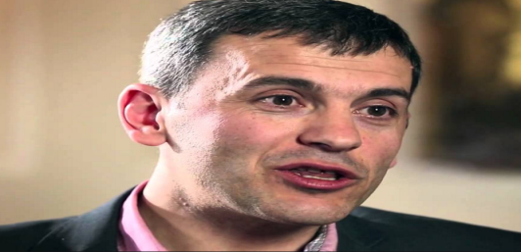
Idiosyncrasy View-Sunnar mentality and opportunities
Pioneered by Dimov (2011) & Sarason et al. (2006; 2010) has a similar but slightly different take on the Evolving, ACTOR–CONTINGENT nature of the entrepreneurial process.
“Opportunity” is predominantly used to denote a subjective and unproven idea.
This idea exists early in the process, but can change considerably during its course, and take on increasing “objectification” over time (Wood and McKinley, 2010).
Under the Evolving Idiosyncrasy View the uniqueness of each “opportunity” is emphasized, and the argument insists on the inseparability of the “opportunity” from the entrepreneur.

Slide 8
Schumpeter versus Kirznerian entrepreneurship
Schumpeter saw the entrepreneurial opportunity anchored in the alpha individuals of society who are responsible through their superior capabilities of engendering innovative forms of entrepreneurship.
The Kirznerian entrepreneur is considered to be a discoverer of opportunities, which are found in the environment because they arise from market disequilibria. (weak vs. strong forms of entrepreneurship)

Slide 9
Schumpeterian Opportunities
The innovative or novel entrepreneur was first classified by economist Joseph Schumpeter (Schumpeter, 1934).
He believed that entrepreneurial activity is the source of innovation in an economy. Hence, the special role of the entrepreneur is to catalyze economic growth by destroying established, outmoded ways of business.
He coined the term, “creative destruction” to describe this process. In Schumpeter’s view, the entrepreneur brings disequilibrium into a market, thereby opening up more entrepreneurial opportunities due to this shift.
Further, Schumpeter outlines that the sources of opportunities for this form of entrepreneurship are found in: technological changes, political/regulatory changes (Schumpeter, 1947).

Slide 10
Kirznerian Opportunities
The Kirznerian, or non-novel form of entrepreneurship comes from Isaac Kirzner’s belief that opportunities are not created by special individuals but are readily available in society to anyone who has the “alertness” to recognize them.
He believes that opportunities occur because the market is in a state of disequilibrium caused by faulty decision making frameworks, which in turn, create shortages and surpluses (I. Kirzner, 1973).
It is in these shortages and surpluses where entrepreneurial opportunities can be found.
Instead of being a creator of opportunities like the Schumpeterian entrepreneur, the Kirznerian entrepreneur is a discoverer of opportunities.

Slide 11
Schumpetarian vs. Kirznerian Opportunities
SCHUMPETARIAN OPPORTUNITIES | KIRZNERIAN OPPORTUNITIES
Disequilibriating | Equilibriating
Requires New Information | Does not require new information
Very Innovative | Less Innovative
Rare | Common
Involves Creation | Limited to Discovery

Slide 12
Schumpetarian vs. Kirznerian Opportunities
Both Schumpeter and Kirzner consider the interaction between the individual and the environment.
Schumpeter states that the individual is the catalyst for the phenomenon of entrepreneurship where he creatively impacts his environment.
Kirzner believes that disequilibrium in the environment (market) is the catalyst with individual alertness playing a deciding role.

Slide 13
Individual Factors Affecting the Discovery Process
Non-Psychological Factors | Psychological Factors
Prior Life Experiences | Absorptive Capacity
Size of Social Network | Recognition of Causal Links
 | Ability to Categorize Information
 | Relationship/Pattern Making
 | Understanding Processes
 | Evaluating Information Accurately

Slide 14
Individual Factors Affecting the Exploitation Process
Non-Psychological Factors | Psychological Factors
Cost | Extroversion
Working Spouse | Need for Achievement
Higher Level of Education | Risk-Taking
Career Experience | Desire for
General Business Experience | Locus of Control
Functional Experience | Self Efficacy
Industry Experience | Overconfidence
Start-up Experience | Intuition
Having a Role Model

Slide 15
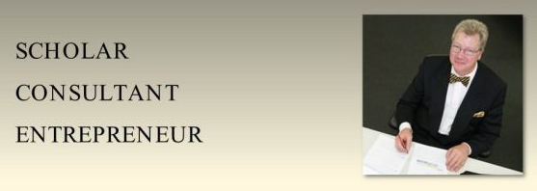
Paper under Discussion
The Harmonized model of entrepreneurial process : 32 into one will go by Hindle, Kevin (2011)
Alternate title:
Skillful Dreaming: Testing a General Model of Entrepreneurial Process with a Specific Narrative of Venture Creation by K. Hindle / Skillful Dreaming / ENTER / 97pp

Slide 16
Abstract
Kevin Hindle has give a parsimonious but comprehensive model of entrepreneurial process that encompasses the seemingly irreconcilable view of Shane, Sarasvathy as well as Baker & Nelson views
MEP emphasizes evaluation (the investigation of opportunity resulting in a viable business model), commitment (to implementation), and management (of implementation) as the three components of entrepreneurial process

Slide 17
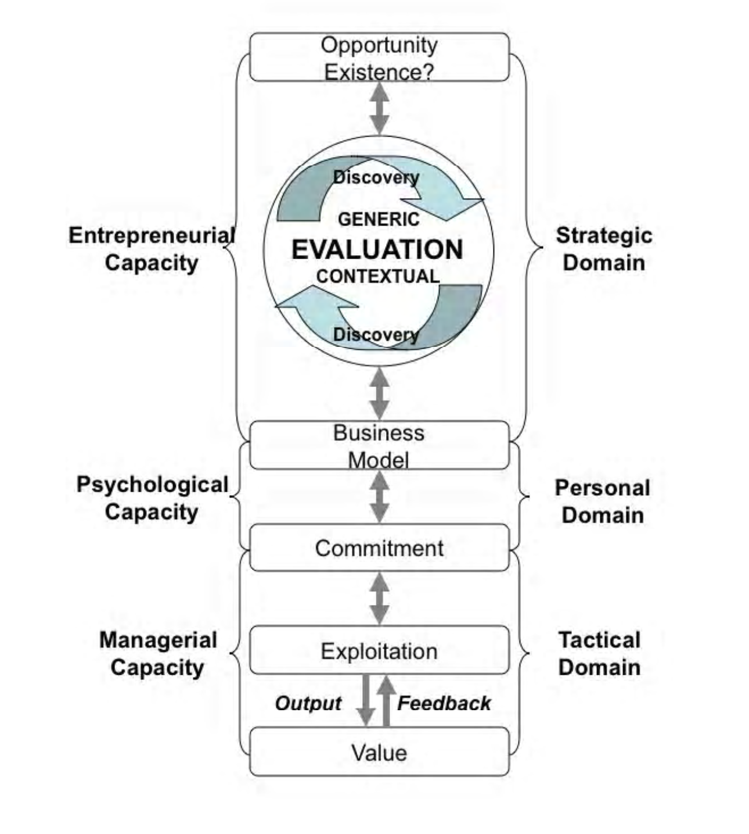
The harmonized conceptual model of entrepreneurial process

Slide 18
Learning for value creation
Opportunity Existence
curricular
curricular
Entrepreneurial Capacity
Discovery
Strategic Domain
Generic
EVALUATION
CONTEXTUAL
Discovery
Business Model
Co-curricular
Psychological Capacity
Personal Domain
Co-curricular
Commitment
Managerial
Capacity
Exploitation
Tactical Domain
Extra-curricular
Feedback
Out Put
Extra-curricular
Value
Source: Adapted from Hindle, 2010)
Value creation for learning

Slide 19
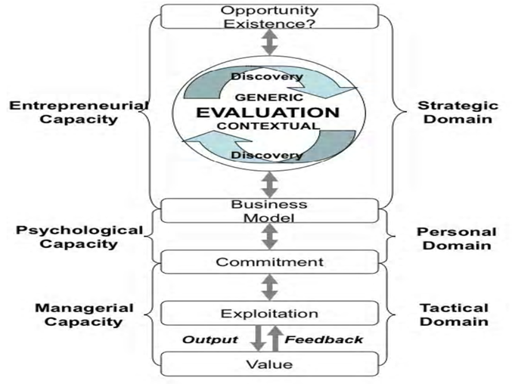
Main Propositions
The strategic Domain: Where, via entrepreneurial capacity, evaluation produces a business model
The personal Domain: where, through psychological capacity, the entrepreneur achiecves commitment
The tactical Domain: Where, through managerial capacity, skillful exploitation determines the achievement of value

Slide 20
The Harmonized Model of Entrepreneurial Process
Parsimonious and comprehensive model. The HMEP emphasizes Evaluation, Commitment and management.
The seemingly irreconcilable differences between three “contending” views of entrepreneurial process — Bricolage (Baker & Nelson, 2005), effectuation (Sarasvathy, 2001, 2008) and causation (Shane, 2003) - can be resolved when the three particular forms of thinking and behavior are viewed as subsets of a broader model of entrepreneurial process (Hindle, 2010a).

Slide 21
Causation; Effectuation; Bricolage
CAUSATION (Proposed by Shane, 2003)
Causal rationality begins with a pre-determined goal and a given set of means, and seeks to identify the optimal – fastest, cheapest, most efficient, etc. – alternative to achieve the given goal.
EFFECTUATION: (Proposed by Sarasvathy, 2001, 2008)
Effectual reasoning: The word “effectual” is the inverse of “causal”.
Effectual reasoning, however, does not begin with a specific goal.
Instead, it begins with a given set of means and allows goals to emerge contingently over time from the varied imagination and diverse aspirations of the founders and the people they interact with.

Slide 22
Causation; Effectuation Cont’d..
While causal thinkers are like great generals seeking to conquer fertile lands (Genghis Khan conquering two thirds of the known world), effectual thinkers are like explorers setting out on voyages into uncharted waters (Columbus discovering the new world).
It is important to point out though that the same person can use both causal and effectual reasoning at different times depending on what the circumstances call for.
While causal reasoning may or may not involve creative thinking, effectual reasoning is inherently creative.
Causal reasoning is based on the logic, To the extent that we can predict the future, we can control it.
Effectual reasoning, however, is based on the logic, To the extent that we can control the future, we do not need to predict it.

Slide 23
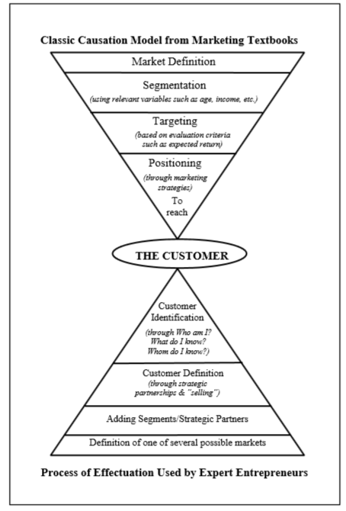

Slide 24
BRICOLAGE: (Proposed by Baker & Nelson, 2005)
Making do with whatever resources are at hand rather than seeking new resources.
Applying combinations of the resources at hand to new problems and opportunities. Taking existing resources and tinkering and/or reframing them so they can be used in new ways.
It is making do by applying combinations of the resources at hand to new problems and opportunities.
It is defined as a way to understand and describe how entrepreneurs under severe resource constraints manage to start and grow new firms despite severe resource disadvantages.
Notes:
Under the causation view an entrepreneur selects a ﬁxed goal and chooses between means to attain it (Fayolle, 2013; Fisher, 2012). In accordance with (Fisher, 2012) such a view sees entrepreneurship as a linear process comprising of discovery, evaluation and exploitation of opportunities as prescribed by (Shane & Venkataraman, 2000). On the other hand, eﬀectuation operates under conditions of uncertainty where entrepreneur changes and reconstructs goals in accordance with available means under control (Fisher, 2012). In the same vein, the term Bricoleur was introduced by Anthropologist Levi Strauss to distinguish between the work activities of an engineer to a “bricoleur” or handyman. Entrepreneurial Bricolage in accordance with (Baker & Nelson, 2005) refers to making-do-by applying combinations of available resources to solve new problems and exploit opportunities.

Slide 25
Towards Comprehensive MEP
The state of the MEP can be enhanced by:
The development of a single, comprehensive model of entrepreneurial process capable of embracing both world views (causal and effectual) and approaches to entrepreneurship without dismissing or giving primacy to either

Slide 26
The harmonized conceptual model of entrepreneurial process

Slide 27
Continued…
Strategic: Distinctive core is entrepreneurial capacity, key activity is evaluation and focal outcome is the development of an opportunity into a business model
Personal: Distinctive core is psychological capacity, key activity involve a range of psychological driven behaviors and focal outcome is commitment.
Tactical: Distinctive core is managerial capacity, key activity involve range of circumstantially appropriate managerial exploitation activities and focal outcome is the achievement of value.

Slide 28
THE END
Thank you for your attentive listening and participation.
The course for sesssional 2 concludes here
So to speak, we have Gartner vs caryland et al Great Debate
Teece’s paper
And
Kevin Hindle paper included for sesssional 2 examination
Good luck!

